Slide 1


DATA WAREHOUSE DESIGN FOR
CO-2 EMISSION DATASET
By Muralidharan V

Slide 2

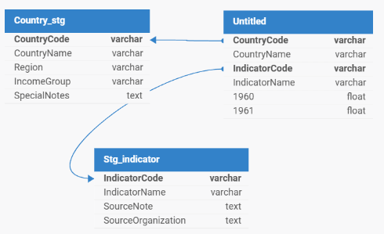
ABOUT
DATASET
This dataset provides comprehensive insights into global CO₂ emissions per capita, measured in metric tons, spanning from 1990 to 2020.
Indicator: CO₂ emissions per capita (metric tons).
Time Period: Data spans from 1990 to 2020 (31 years).
Geographic Coverage: Includes all countries globally.
Categorization:
Income Groups: High, middle, and low-income categories.
Regions: Grouped by regions such as East Asia & Pacific, Europe & Central Asia.

Slide 3
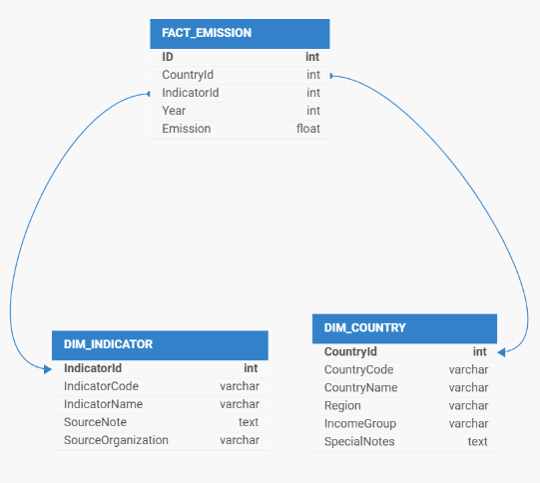
UPDATE
STRATEGY
Dimension Tables
Tables: DIM_COUNTRY, DIM_INDICATOR.
Update Strategy:
Slowly Changing Dimension Type 1 (SCD 1) is used for dimensions.
Existing records are updated directly with new values, overwriting historical data.
No historical tracking is maintained, ensuring the dimension tables always reflect the latest information.
Fact Table
Table: FACT_CO2_EMISSION.
Update Strategy:
SCD Type 1 is applied for updates in fact data.
New rows are inserted for new records.
Existing records are updated based on primary/foreign key relationships (COUNTRY_ID and INDICATOR_ID, ).

Slide 4
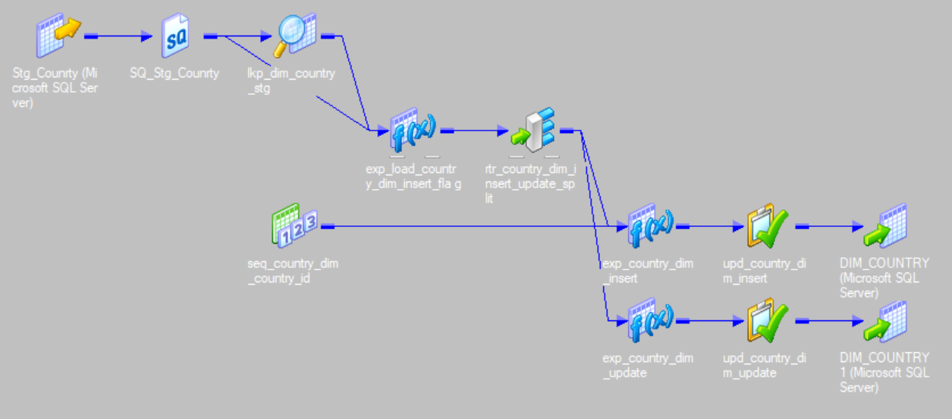
MAPPINGS
DIMENSION COUNTRY

Slide 5
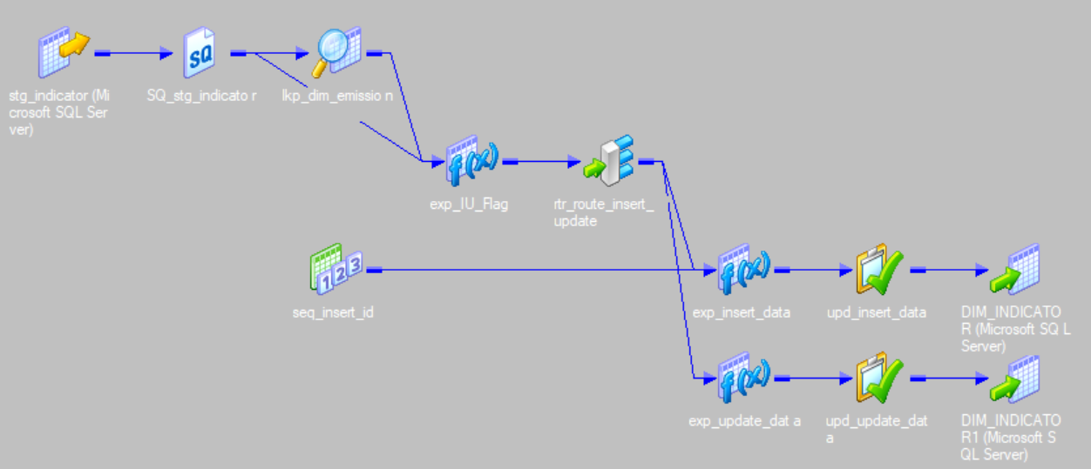
MAPPINGS
DIMENSION INDICATOR

Slide 6
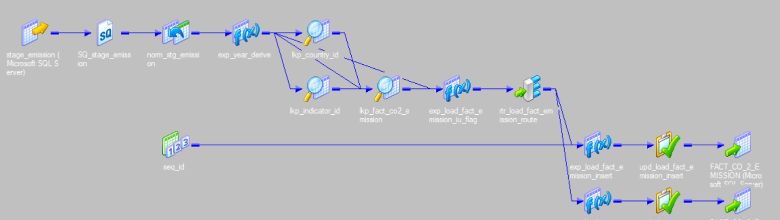
MAPPINGS
FACT TABLE

Slide 7
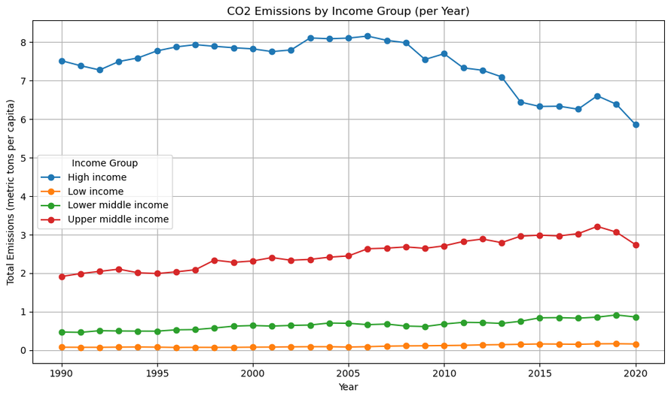
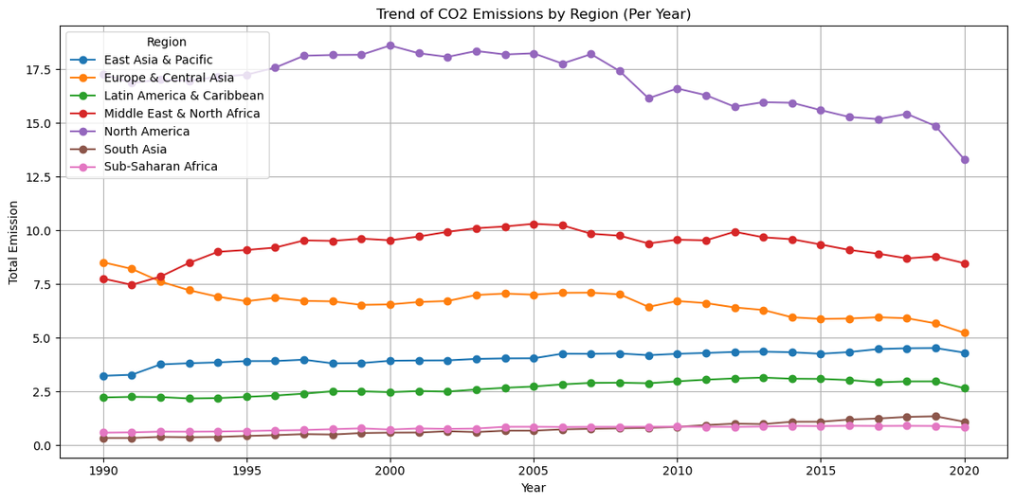
CHARTS
Grouped by Income group
Grouped by Region

Slide 8
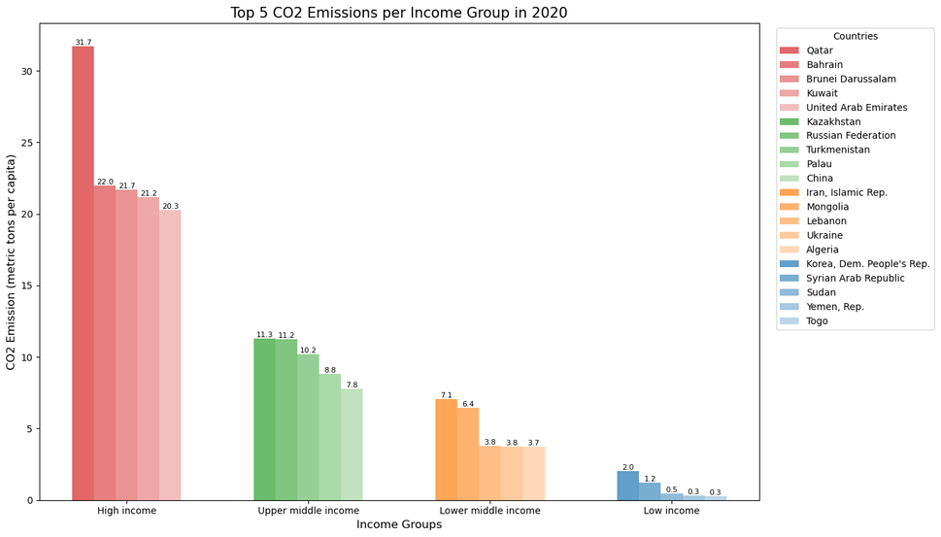
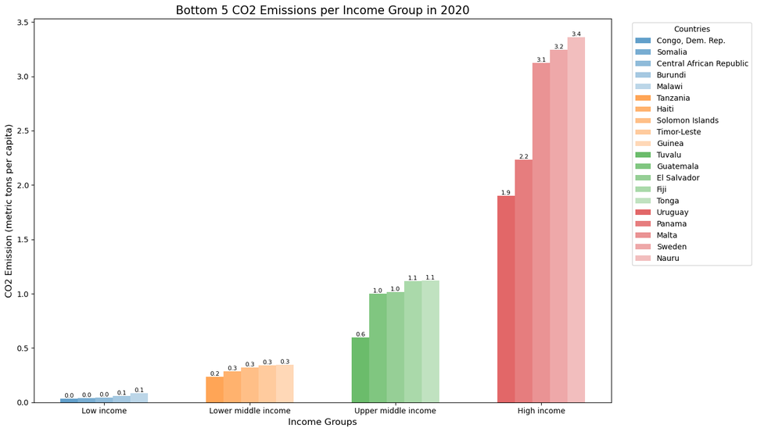
CHARTS
Top 5 in each Income Group
Bottom 5 in each Income Group

Slide 9
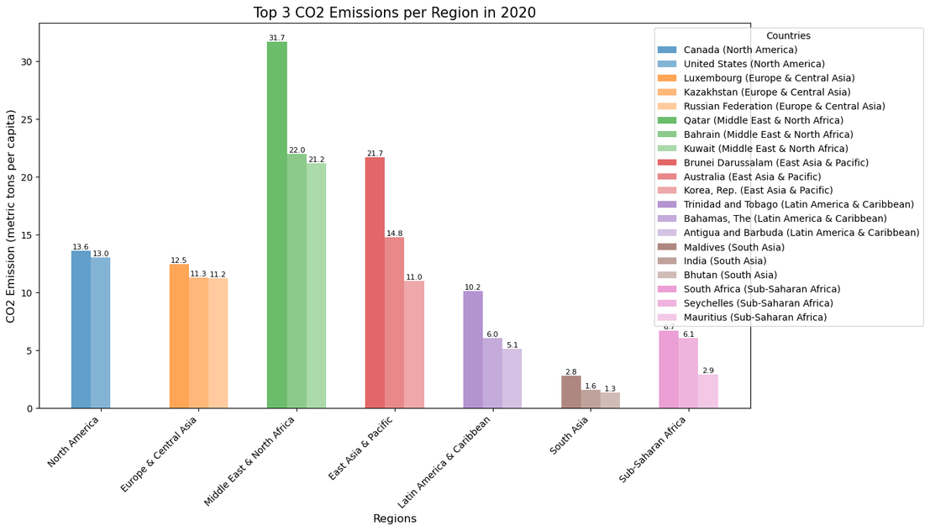
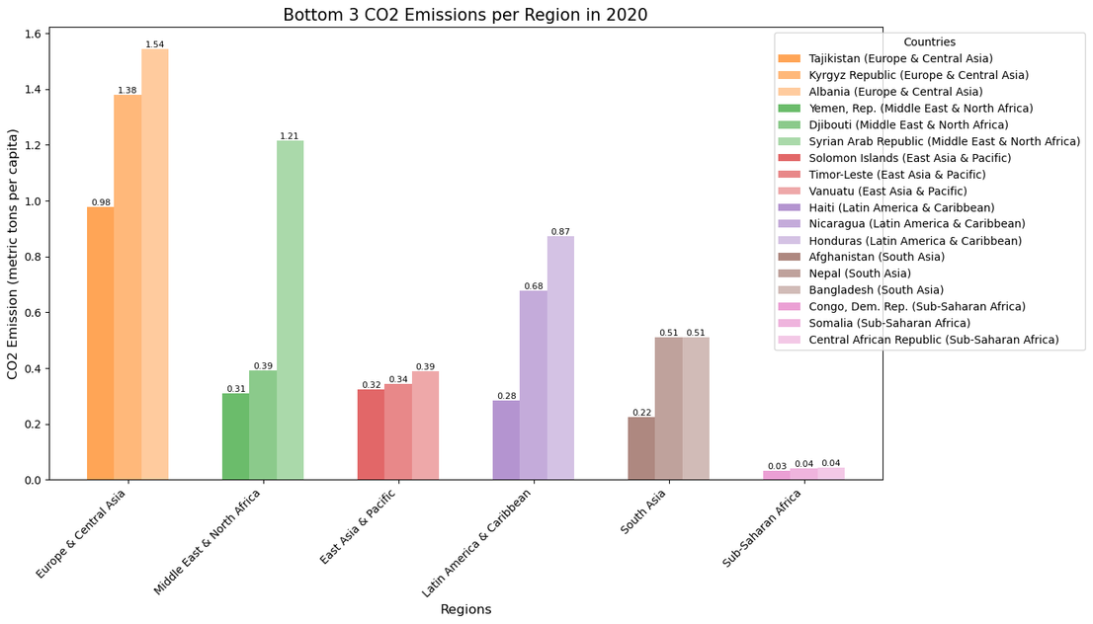
CHARTS
Top 3 in each Region
Bottom 3 in each Region

Slide 10
INSIGIGHT
FROM DATA
On performing certain aggregations, It is evident that there is huge difference in emission per capita from High income group even compared to that of upper middle income group
On comparing in terms of regions, Countries in South Saharan region and South asian region produce less than 1 Tonne CO2 per capita, whereas North American countries produce more than 175 tonnes of C02 per capita in certain durations
There is a clear decline in CO2 emission per-capita from 2010, indicating improved measures in reducing CO2 emissions.

Slide 11
THANK YOU

